Slide 1
Therapeutic Dual Inhibition of HER2 Pathway for Metastatic Colorectal Cancer (mCRC): The HERACLES Trial
Abstract 565
Siena S, Sartore-Bianchi A, Trusolino L, Martino C, Bencardino K, Lonardi S, Leone F, Zagonel V, Bertotti A, Valtorta E, Siravegna G, Amatu A, Vanzulli A, Regge D, Ghezzi S, Ciardiello F, Veronese S, Comoglio PM, Bardelli A, Marsoni S

Slide 2

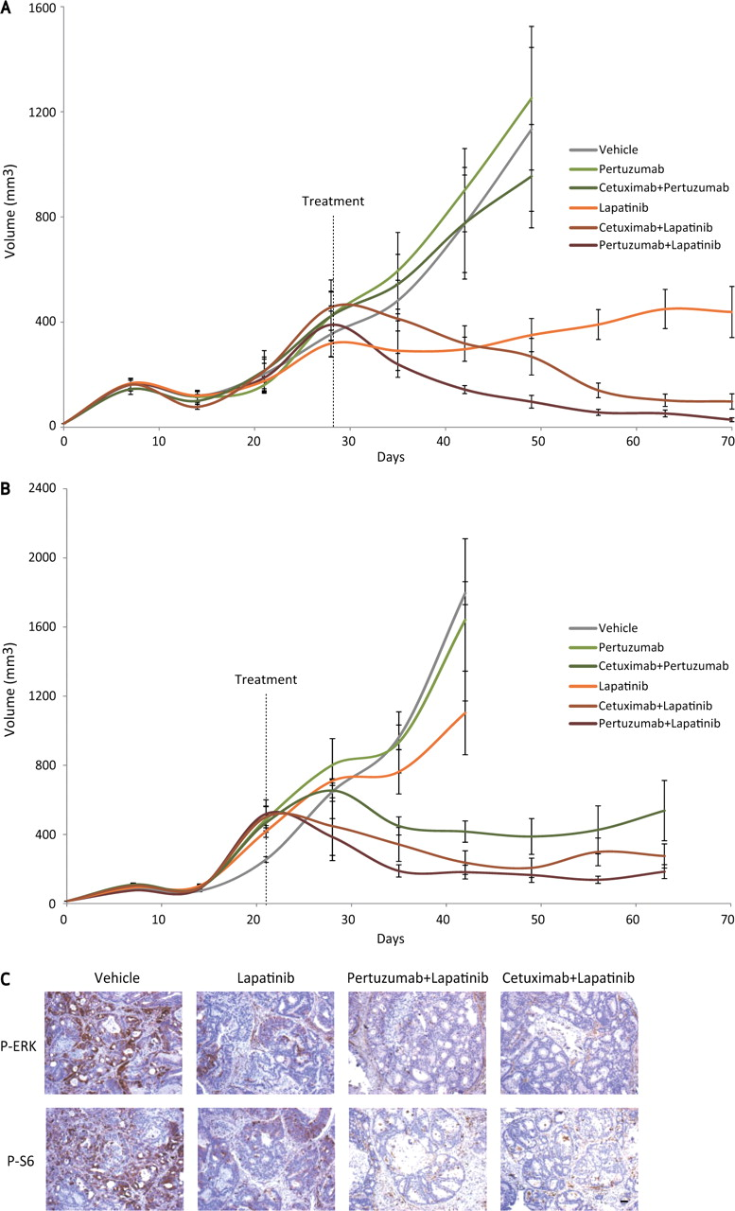
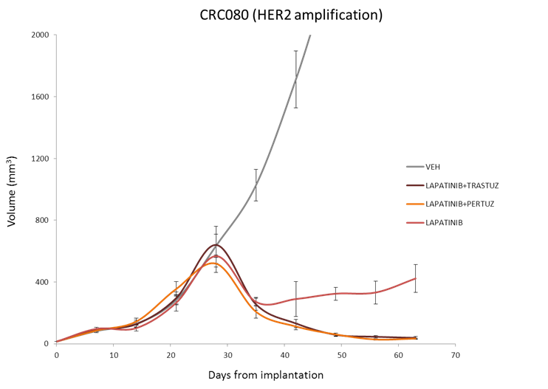
Anti-EGFR and Anti-HER2 Therapies in Xenopatients With Cetuximab-Resistant HER2-Amplified mCRC
Xenopatient M077
Xenopatient CRC080
Growth curves of tumors in xenopatients derived from cetuximab-resistant quadruple-negative HER2-amplified mCRC (n = 5 for each treatment arm)
Bertotti A, et al. Cancer Discov. 2011;1(6):508-523
Siena S, et al. J Clin Oncol. 2015;33(suppl 3): Abstract 565.
Notes:
Effect of anti-EGFR and anti-HER2 therapies in cetuximab-resistant, HER2-amplified metastatic colorectal cancer xenopatients. A, B, growth curves of tumors in xenopatients derived from cetuximab-resistant, quadruple-negative, HER2-amplified cases M077 (A) and M091 (B) (n = 5 for each treatment arm). C, immunohistochemistry assessment with the indicated antibodies of representative tumors from case M077 at the end of treatment. Scale bar, 100 μm.

Slide 3

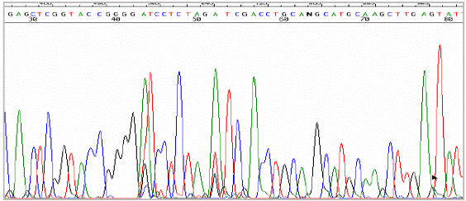
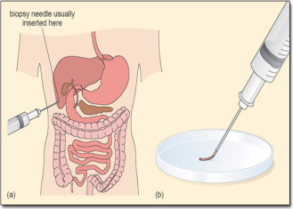
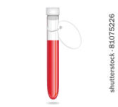

Study Flow Chart
Advanced metastatic KRAS WT CRC patients refractory to: Fluoropyrimidines, irinotecan, oxaliplatin, cetuximab/panitumumab, and bevacizumab
Screen for HER2 by IHC and FISH on last available FFPE
HER2 negative
OFF TRIAL
HER2 positive
Informed Consent
Whenever possible
Tumor Assessment (RECIST 1.1) Q8-9 weeks
IRCC TARGET
NGS panel
HERACLES
Trastuzumab IV + Lapatinib OS
(4mg/kg load + 2mg/kg/wk) (1000 mg/die )
PD
Imaging-guided biopsy
Liquid Biopsy
Q 2weeks
X4
X4
X4
X4
IRCC TARGET
NGS panel
ctDNA Mutations: KRAS,NRAS, BRAF,PIK3CA; Amplification: HER2, KRAS, MET; Custom Exome Panel in nonresponders and at relapse serum quantification of Extracellular Domain of HER2 (HER2-ECD)
Siena S, et al. J Clin Oncol. 2015;33(suppl 3): Abstract 565.

Slide 4
Study Design
Objective | Activity of lapatinib + trastuzumab in HER2 amplified metastatic colorectal cancer
Design | Phase II, open label, multicentric single-stage design according to Fleming and A’Hern
Endpoints | Objective response (primary), safety, and time-to-progression (TTP, secondary)
Population | HER2+, mCRC after failures of previous chemotherapy, antiangiogenesis, and antiEGFR therapies
Main inclusion criteria | Pathology: KRAS exon 2 wild type (WT); HER2-positivity (IHC3+ or IHC2+/SISH+) according to HERACLES diagnostic criteria Prior therapies: Unless otherwise contraindicated should have received and failed fluoropyrimidine-, oxaliplatin-, irinotecan-, cetuximab- or panitumumab-containing therapy regimens Performance status ECOG 0-1 Measurable disease according to RECIST 1.1 Adequate vital organ function (cardiac, bone marrow, renal, liver)
Treatment | Lapatinib 1000 mg po qd Trastuzumab 4 mg/kg IV load dose, then 2 mg/kg IV weekly
Tumor assessment | RECIST 1,1 imaging every 8 weeks and liquid biopsy every 2 weeks Double-lecture centralized response assessment, Mint Lesion® software assisted
Statistical assumptions | H0 10%, H1 30%, α = 0.05 and power =0.85 Primary endpoint: Objective Response according to RECIST 1.1
Sample size | 27 patients; 6 responses must be observed for the study to be positive
Siena S, et al. J Clin Oncol. 2015;33(suppl 3): Abstract 565.

Slide 5
N 836
KRAS WT screened
Study Consort
N 72
IHC 2+/3+ (8,6%)
N 44
FISH+ (5,3%_{tot} 61%_{2+/3+})
IHC 3+
N 33
IHC 2+
N 11
21 HER2+ did not meet inclusion criteria (no prior anti-EGFR therapy or comorbidities), or too early
IHC 3+
N 17
IHC 2+
N 6
N 23
Enrolled and treated
1 too early
N 22
Evaluable for response
N 13
3+ GCNV ≥20
N 4
3+ GCNV <20
N 5
2+ GCNV <20
Siena S, et al. J Clin Oncol. 2015;33(suppl 3): Abstract 565.

Slide 6
Patients Characteristics
Characteristics |  | Patients
 |  | N | %
Age | Median | 63
 | Range | 40-86
Gender | Females | 2 | 9%
 | Males | 21 | 91%
Performance status | ECOG 0/1 | 23 | 100%
Tumor site | Colon | 19 | 85%
 | Rectum | 3 | 15%
Extent of disease | One site only | 3
 | Liver | 2
 | Lung | 1
 | Multiple sites | 20
 | Liver | 12
 | Lung | 11
 | Nodes | 9
 | Other sites | 12
Prior treatments | Median number of previous line for metastatic disease (range) | 5 (2-8)
 |  | N | %
 | More than 3 previous lines | 20 | 87%
 | Prior cetuximab or panitumumab | 23 | 100%
 | Patients responding to cetuximab or panitumumab | 0 | 0%
 | Prior bevacizumab treatment* | 10* | 100%*
*Only 10/23 patients were eligible for bevacizumab treatment
Siena S, et al. J Clin Oncol. 2015;33(suppl 3): Abstract 565.

Slide 7
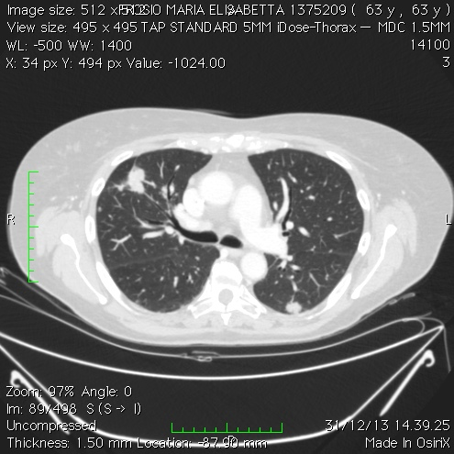
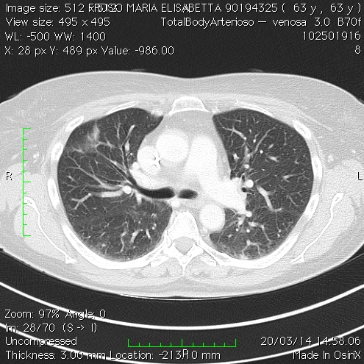
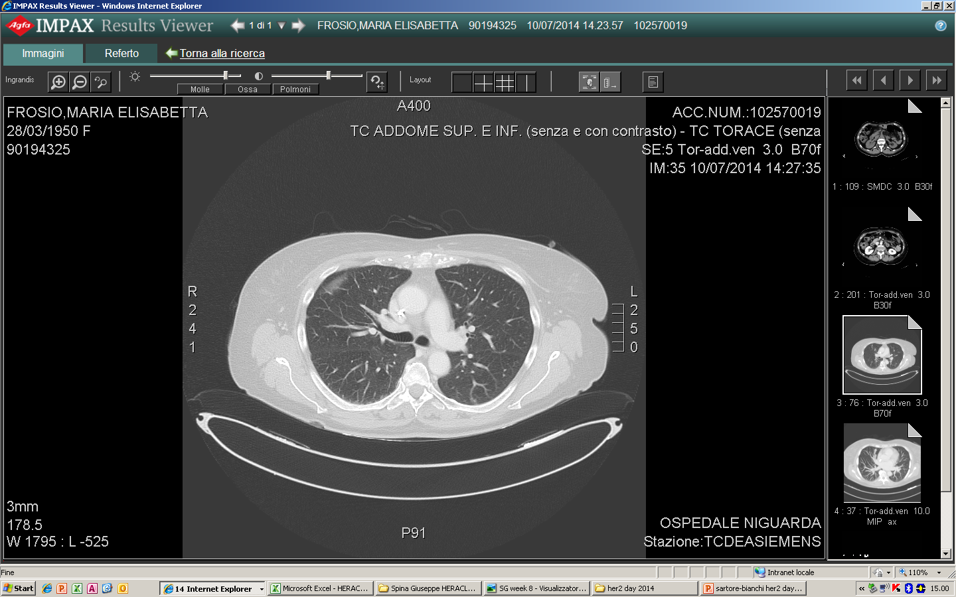
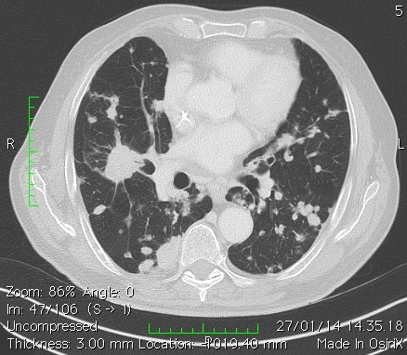
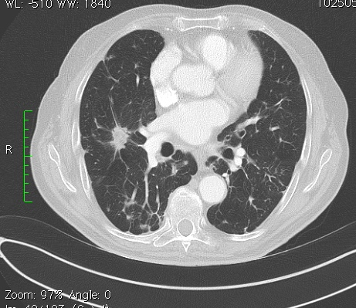
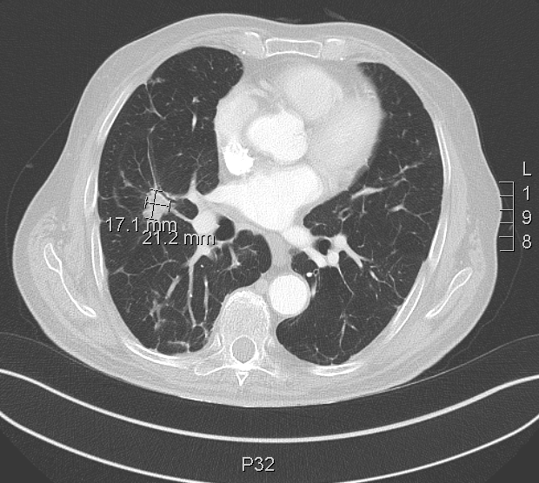
Patient #121015: Age 62, 5 Prior Chemotherapies + Panitumumab + Bevacizumab + Regorafenib
Dec 31, 2013
Baseline
March 20, 2014
Week 8 partial respnse (PR)
[…]
July 10, 2014
Week 24 PR
Patient #121016: Age 86, 4 Prior Chemotherapies + Panitumumab
Jan 27, 2014
Baseline
March 23, 2014
Week 8 PR
[…]
July, 15, 2014
Week 24 PR
Siena S, et al. J Clin Oncol. 2015;33(suppl 3): Abstract 565.

Slide 8
Objective Response Rate by HER2 IHC Score or Gene Copy Number (GCN) Variation
N 7
N 10
N 5
N 8
P = .022*
P = .134*
N 7
N 7
N 17
N 5
N 14
N 8
*Fisher’s exact test
IHC, Immunohistochemistry; SD, stable disease; PD, progressive disease
Siena S, et al. J Clin Oncol. 2015;33(suppl 3): Abstract 565.

Slide 9
Response: Spaghetti Plot
Ongoing
PD target lesions
PD new lesion
Clinical PD
PR treshold vs Baseline
HER2 3+ GCN>20
HER2 3+ GCN<20
HER2 2+ GCN<20
*Three patients are not displayed: 122025 (IHC 2+ GCN<20) too early (not yet assessed); 121011 (IHC 3+ GCN>20) and 121013 (IHC 3+ GCN<20) early clinical PDs
Siena S, et al. J Clin Oncol. 2015;33(suppl 3): Abstract 565.

Slide 10
Response: Waterfall Plot
PR treshold vs baseline
ONGOING
HER2 3+ GCN>20
HER2 3+ GCN<20
HER2 2+ GCN<20
*Three patients are not displayed: 122025 (IHC 2+ GCN<20) too early (not yet assessed); 121011 (IHC 3+ GCN>20) and 121013 (IHC 3+ GCN<20) early clinical PDs.
Siena S, et al. J Clin Oncol. 2015;33(suppl 3): Abstract 565.

Slide 11
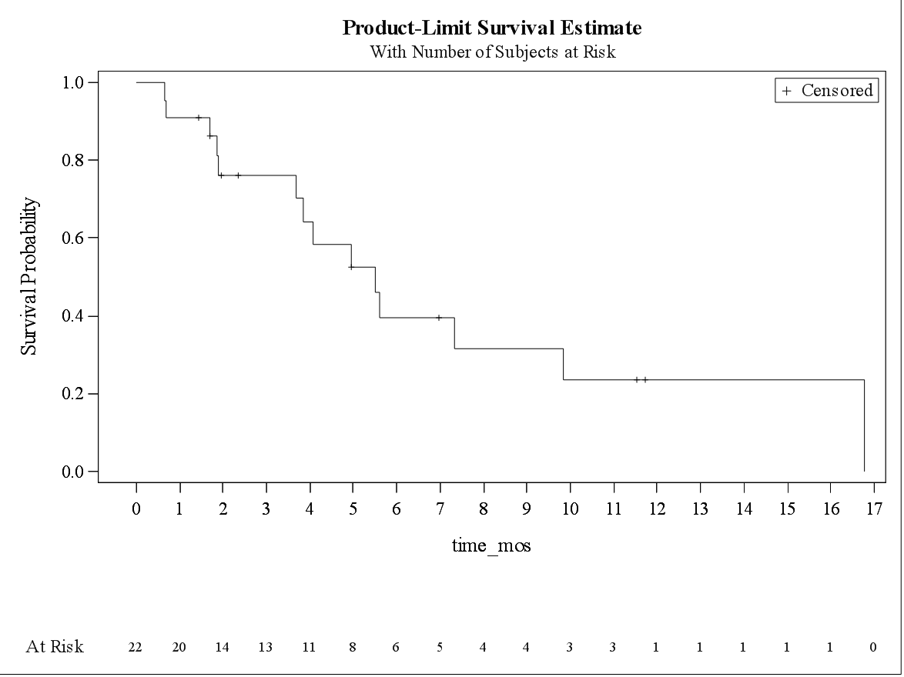
Time-to-Progression: All Patients
Median = 5.5 months (95 CL 3.7-9.8)
Siena S, et al. J Clin Oncol. 2015;33(suppl 3): Abstract 565.

Slide 12
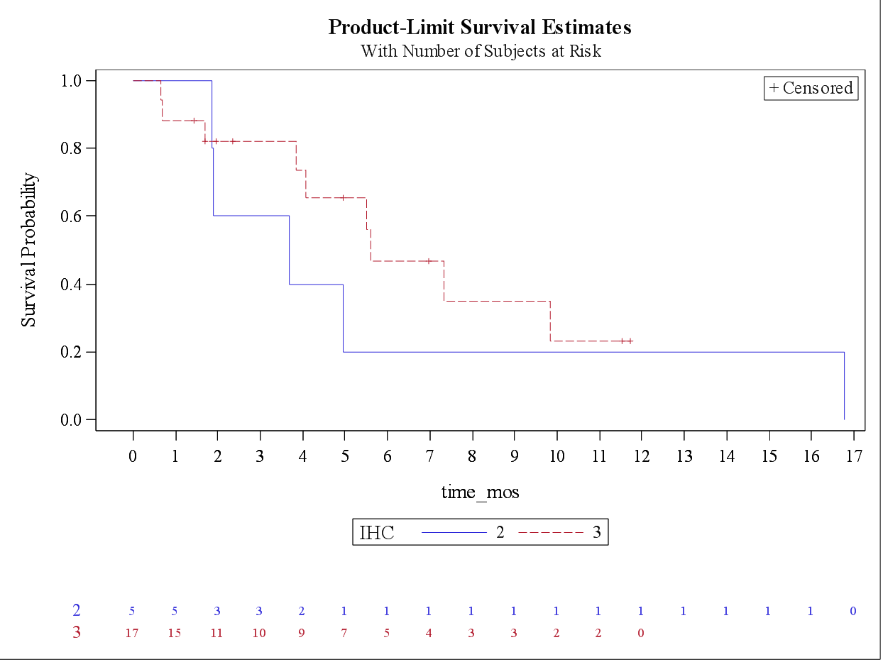
Time-to-Progression by HER2 IHC Score
Median
2+ = 3.7 months (95 CL 1.9-16.8)
3+ = 5.6 months (95 CL 3.8 – not reached)
P = NS
+
3+
At risk
IHC 2+
IHC
+
Siena S, et al. J Clin Oncol. 2015;33(suppl 3): Abstract 565.

Slide 13
Time-to-Progression by HER2 GCN
MEDIAN
<20 = 3.8 months (95 CL 0.7-5.6)
>20 = 7.3 months (95 CL 4.1 – not reached)
P = .09
At risk
GCN
GCN
Siena S, et al. J Clin Oncol. 2015;33(suppl 3): Abstract 565.

Slide 14
Drug Related Toxicities
GI Tract | Total events | % of total AEs | Grade 3 | % of total G3 AE
Diarrhea | 54 | 31 | 0
Nausea/Vomiting | 16 | 9 | 0
Abdominal pain | 6 | 3 | 0
Mucositis | 2 | 1 | 0
SKIN & ANNEXES
Paronychia | 16 | 9 | 0
Rash/dermatitis | 19 | 11 | 1 | 17
Pruritis | 4 | 2 | 0
Polliculitis | 1 | 1 | 0
Erythemia | 2 | 1 | 0
Xerosis | 4 | 2 | 0
SYSTEMIC
Faitgue | 28 | 16 | 3 | 50
Loss of appetite | 2 | 1 | 0
Chills | 1 | 1 | 0
Parathesia | 1 | 1 | 0
Hand and Foot | 5 | 3 | 0
SENSE ORGAN
Conjunctives | 1 | 1 | 0
Dysgeusia | 1 | 1 | 0
Dysphonia | 1 | 1 | 0
LABORATORY
Anemia | 3 | 2 | 0
Hypomagnesaemia | 1 | 1 | 0
CARDIOVASCULAR
Hypertension | 3 | 2 | 1 | 17
LVEF drop | 1 | 1 | 1 | 17
Epistaxis | 1 | 1 | 0
Total | 173 | 100 | 6 | 100
Siena S, et al. J Clin Oncol. 2015;33(suppl 3): Abstract 565.

Slide 15
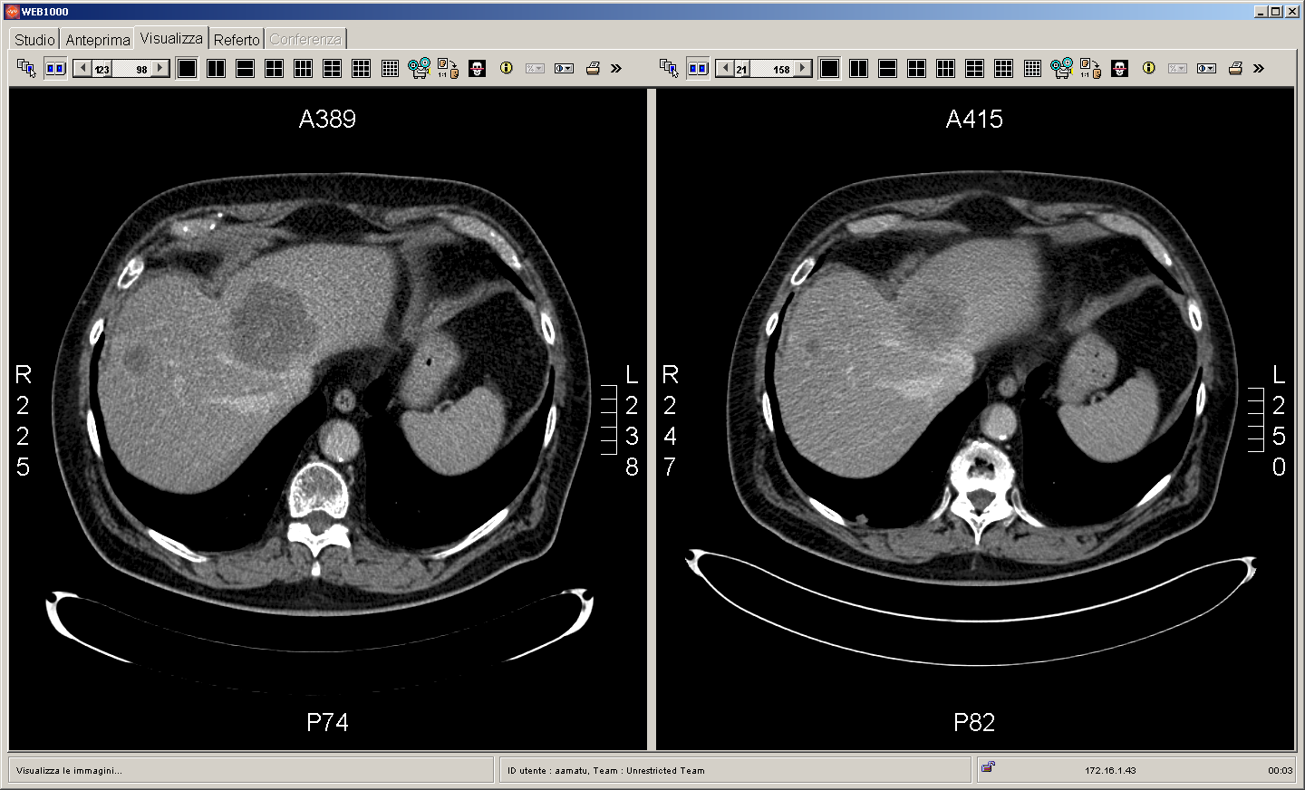
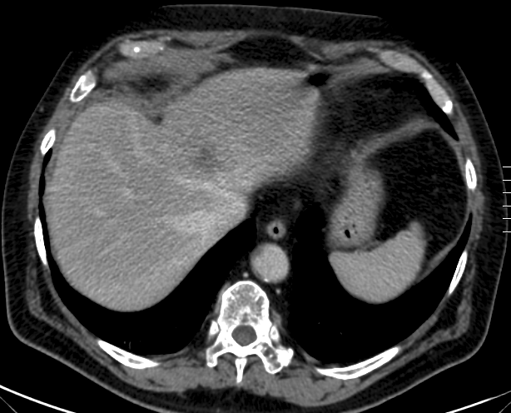
Patient #121001: Liquid Biopsy and HER2-ECD
Determination of HER2 ctDNA by droplet digital PCR on plasma. HER2 Ectodomain by ELISA on serum
%
%
%
%
%
%
72 mm
55 mm
45 mm
Siena S, et al. J Clin Oncol. 2015;33(suppl 3): Abstract 565.

